Slide 1
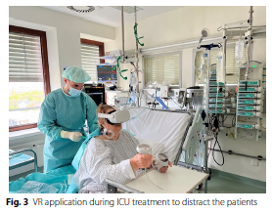
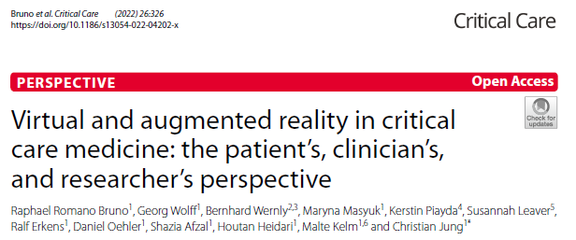
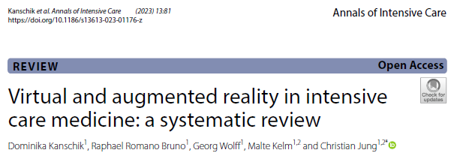
Immersive Virtual Reality
VR: immersive (headset) vs non-immersive (computer game)
Immersion is the experience of being absorbed (termed, ‘presence’), forgetting their embodied presence and thus responding as if the environment is real.
ICU Use cases: Relaxation (several feasibility studies), Cognitive/physical mobilization (1 RCT), Distraction/pain control (1 RCT pre-op), Delirium*, Sleep (1 +RCT)
→all are small, variable definitions/procedures, limited generalizability (barriers likely local)

Slide 2
Barriers
Patient | Providers | System
Apprehension Loss of control? Digital divide? “Cyber Sickness” Isolation | Competing goals Skepticism Perceptions re: pt Ethical? (delirium) | Competing tasks Equipment
Gap:
Under-replicated
Barriers likely local
Provider and Patient perceptions under investigated: is there a gap?
Is participation actually lower than other types of interventions (vs general research effect?
Who participates?
Aims:
Determine if VR devices are usable in our ICU
Assess the logistical barriers
Understand current provider (RN) and patient perceptions
Do they change pre-post?

Slide 3
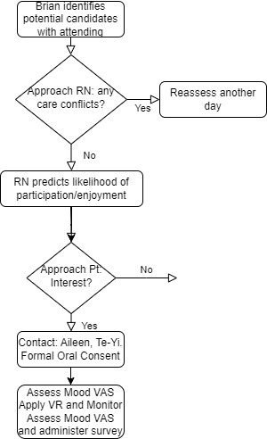
Enrollment Flow
Inclusion | Exclusion
18+ No severe visual/auditory impairments No ID precautions Awake/Alert, Eyes open for 30s | Inability to provide informed consent Head/facial abnormality precluding headset Psychotic d/o Recent MDD, Epilepsy, TBI Admission for OD
Notes:
Aileen Gabriel, MS, study coordinator, Department of Biomedical Informatics Te-Yi Tsai, MS, research assistant, Department of Biomedical Informatics

Slide 4
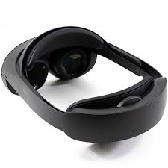

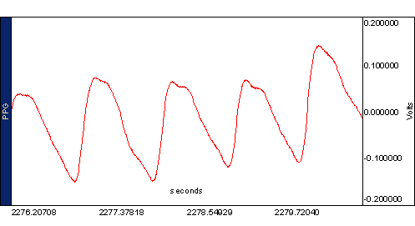
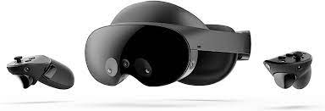
Interventions
Apply VR headset:
content of their choosing,
aim for 5-15 minutes
Apply Biopac:
ppg, oximeter, plethy belt, ekg
No EHR, No Vital Signs

Slide 5
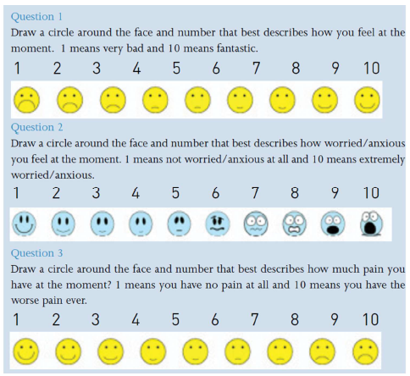
Outcomes:
Single visit, no PHI [minimal risk, oral consent]
Qualitative Interview:
Please describe your experience using the VR headset
In what ways did this help you feel better?
What problems did you have using this headset?
How did this compare to what your initial expectations?
How do you think we could use this in the future with other patients?
Quantitative:
Vital signs: HR, SpO2, RR (belt), Adrenergic tone (ppg)
Mood analysis (pre- and post-)
RN discrimination/calibration predicting interest.

